Slide 1
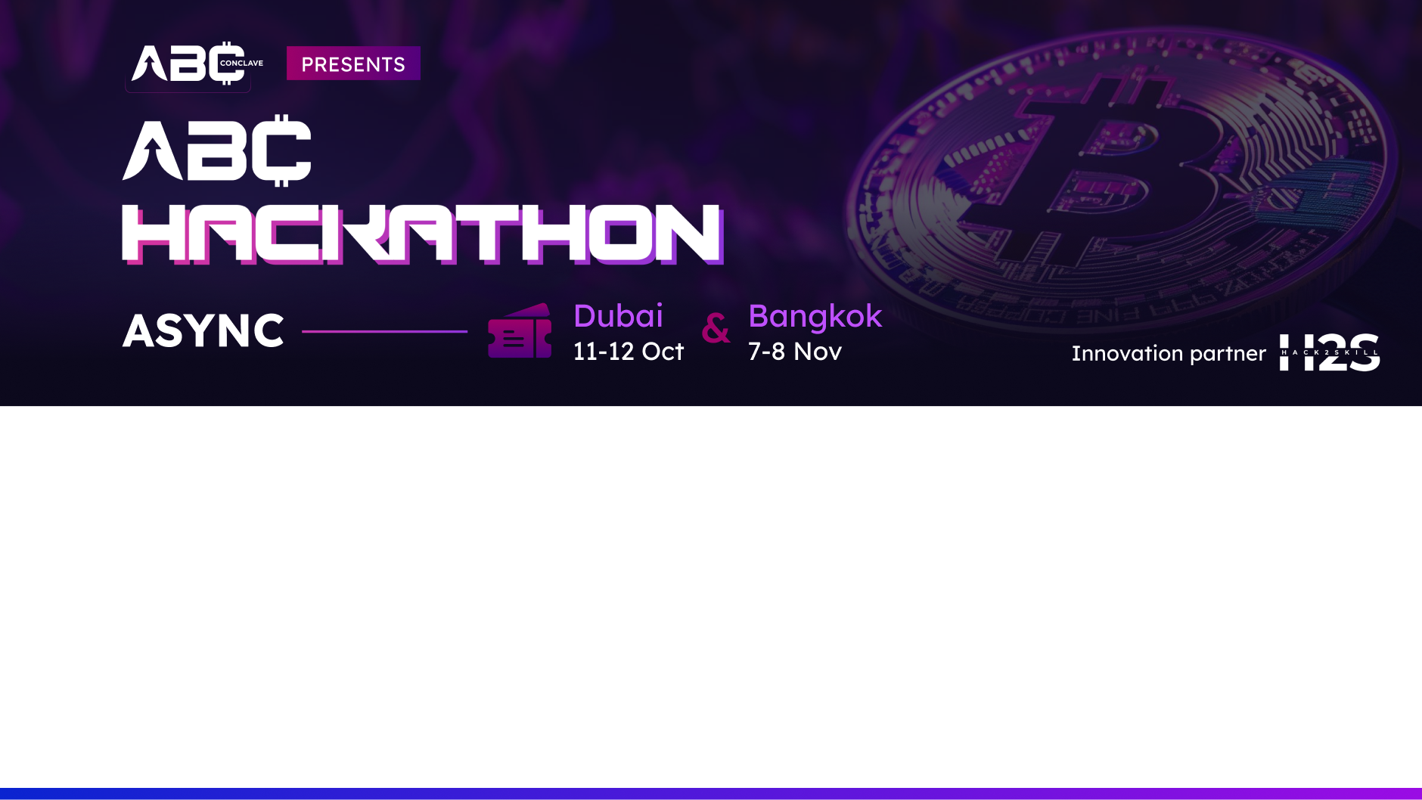
Team Details
Team name: Coder@
Team leader name: Shruti Ojha
Problem Statement: AI-powered decentralized applications (dApps)

Slide 2
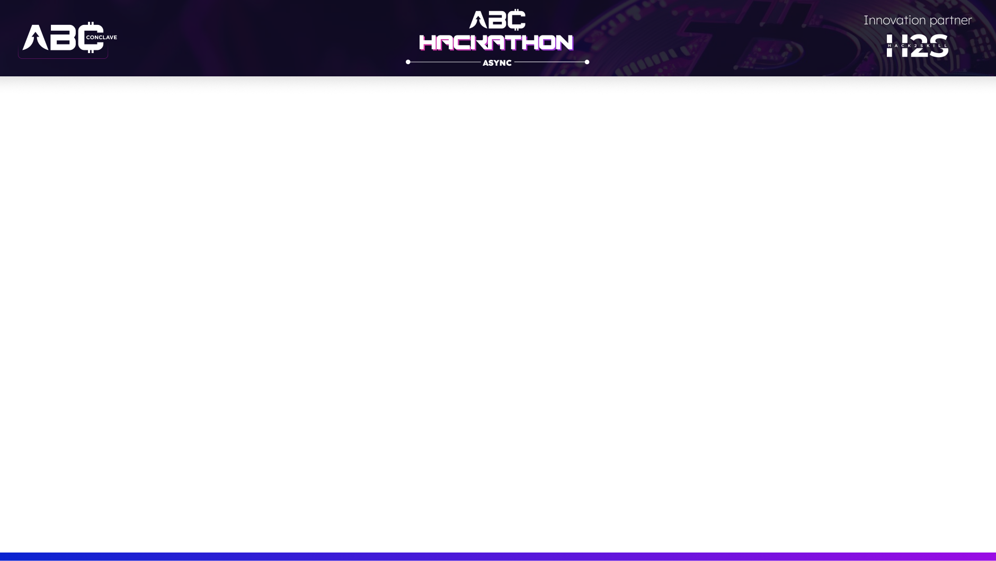
Brief about the idea
AI can be a leading enabler of improvement for blockchain technology, the most important of which is undoubtedly the auto-execution and, therefore, efficiency and safety of smart contracts. AI algorithms can analyze huge data sets for early signs of anomalies and detect novel threats that enhance security within a blockchain network. AI also optimizes blockchain networks in terms of scalability, thereby allowing for higher transaction volumes and performance. The use of homomorphic encryption, which allows computations on the encrypted data while preventing the leakage of sensitive information, also boosts privacy on the blockchain. AI makes it easier to manage data storage on the blockchain as it is distributed and large in amounts, thus making it easily accessible and very easy to analyze. Finally, AI can help initiate the development of standards and protocols that ensure smooth communication and data exchange amongst different blockchain networks and facilitate interoperability.

Slide 3
Opportunities
a. How different is it from any of the other existing ideas?
Several key factors must be considered so as to determine how the proposed idea differs from other solutions. The first one is innovation, determining whether this idea is introducing new technologies or methodologies never witnessed before, such as carrying out something related to AI or blockchain that hasn't been done before. Possibly the development of new AI-based algorithms for smart contracts or just better data management techniques. Problem focus: the idea must target a specific pain point or niche problem that current solutions will not cover-for instance, improved security or privacy for a particular sector. Efficiency: does the solution provide quicker, cheaper results than alternatives, especially in the optimization of, for example, transaction handling or smart contract execution? The fourth aspect is integration, because the proposition has to achieve full interoperability among blockchain networks and AI systems during execution. Most of the existing solutions suffer from compatibility issues, and this is yet another distinguishing factor. Finally, unique features: the idea must introduce some features that others don't have, such as advanced privacy techniques or better user experiences, which will ensure a place at the top among the other solutions in the marketplace.

Slide 4
Opportunities
b. How will it be able to solve the problem?
The proposed solution applies AI and blockchain to solve major challenges in the area of inefficiencies, security, scalability, privacy, and interoperability. AI-enabled automation: fully automates smart contract execution in order to ensure transactions faster, more accurately, with minimal human intervention; therefore, stamping out the inefficiencies which are inherent in current systems. AI-based secured algorithms shall monitor the blockchain networks in real-time in order to detect anomalies; hence the fact that they would thwart any impending attacks, which is a very strong factor enhancing security while heavily reducing fraud chances.In terms of scalability, AI will optimize the performance of blockchain networks to process more transactions at faster speeds without compromising efficiency. This is one of the common bottlenecks in blockchain: the processing of slow transaction processing. For privacy, AI-powered techniques like homomorphic encryption will permit computations on encrypted data without leaking any information about the data being computed.
Data management will be improved, because AI will process and analyze large sets of data stored in blockchain systems, increase access to it, and provide valuable insights into it. Finally, there will be interoperability, since seamless communication and exchange of data between any number of blockchain networks will be ensured for the elimination of compatibility issues that challenge the existing solutions. In such a way, this approach would cover inefficiencies, enhance security, and ensure scalable, privacy-preserving data management within blockchain environments.

Slide 5
Opportunities
c. USP of the proposed solution
USP for the proposed solution is the seamless integration of AI and blockchain technologies towards solving multiple problems concerning efficiency, security, scalability, privacy, and interoperability under a single, homogenous platform. Unlike most prevalent existing solutions that focus on addressing one problem at a time, this approach makes use of AI-driven automation in optimizing smart contracts, increasing **real-time security** through AI-based monitoring, and fine-tuning scalability with increasing volumes of transaction by enhancing performance capabilities of the blockchain. The AI-driven privacy features, such as homomorphic encryption, securely enables data analysis without forfeiting the confidentiality, which is a very rare capability in the current blockchain systems. This solution will feature interoperability with perfectly seamless communication and further data transfer between other blockchain networks, providing solutions to compatibility issues that knock down many blockchain systems. In this regard, its holistic approach to blockchain management makes it more efficient, secure, scalable, and interoperable than other possible competitors.

Slide 6
List of features offered by the solution
AI Enhancing Blockchain:
Smart Contracts: Automation and optimization of smart contract execution for improved efficiency.
Security: Real-time anomaly detection and threat identification through AI-driven algorithms.
Data Management: Enhanced organization, processing, and analysis of blockchain data via AI.
Applications of AI and Blockchain Together:
1.Supply Chain Management: Improved transparency and efficiency in supply chain operations.
2. Healthcare: Enhanced data sharing and patient privacy through secure blockchain integration.
3. Finance: Streamlined processes and improved fraud detection in financial transactions.
Blockchain Enhancing AI:
Data Integrity: Ensures authenticity and tamper-proof data sources for AI applications.
Decentralized AI: Supports distributed AI models across networks, reducing central control.
AI Model Sharing: Facilitates secure and transparent sharing of AI models among users.
Future Outlook:
1. AI-Driven Decentralized Apps (dApps): Intelligent dApps providing greater autonomy on blockchain.
2. Autonomous Organizations: Decentralized, self-governing organizations enabled by AI and blockchain integration.

Slide 7
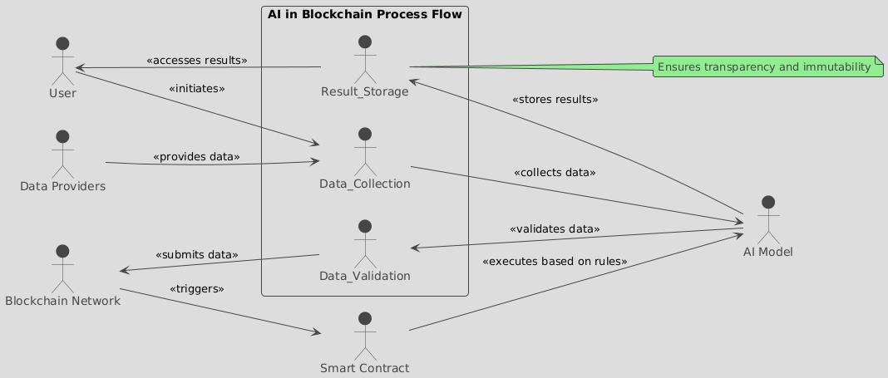
Process flow diagram or Use-case diagram

Slide 8
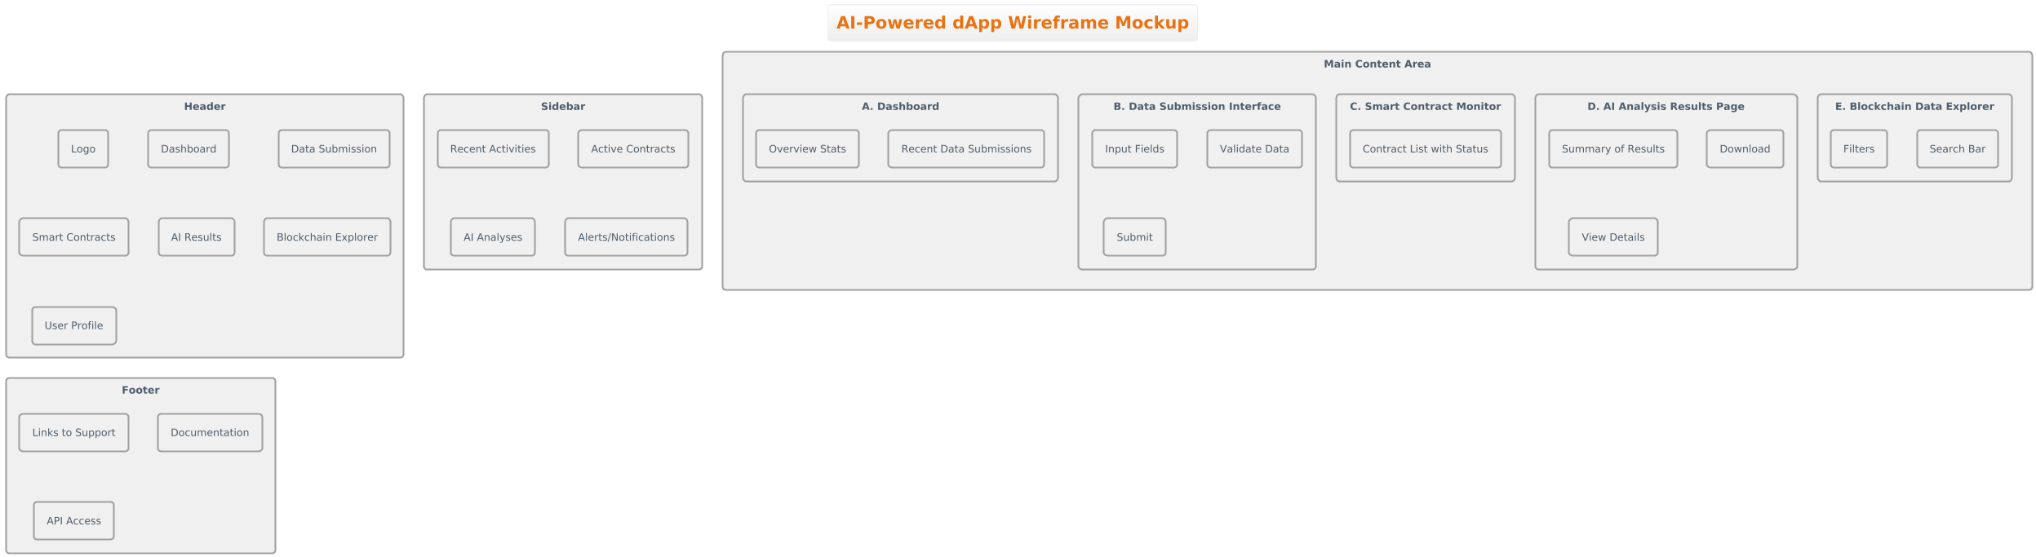
Wireframes/Mock diagrams of the proposed solution (optional)

Slide 9
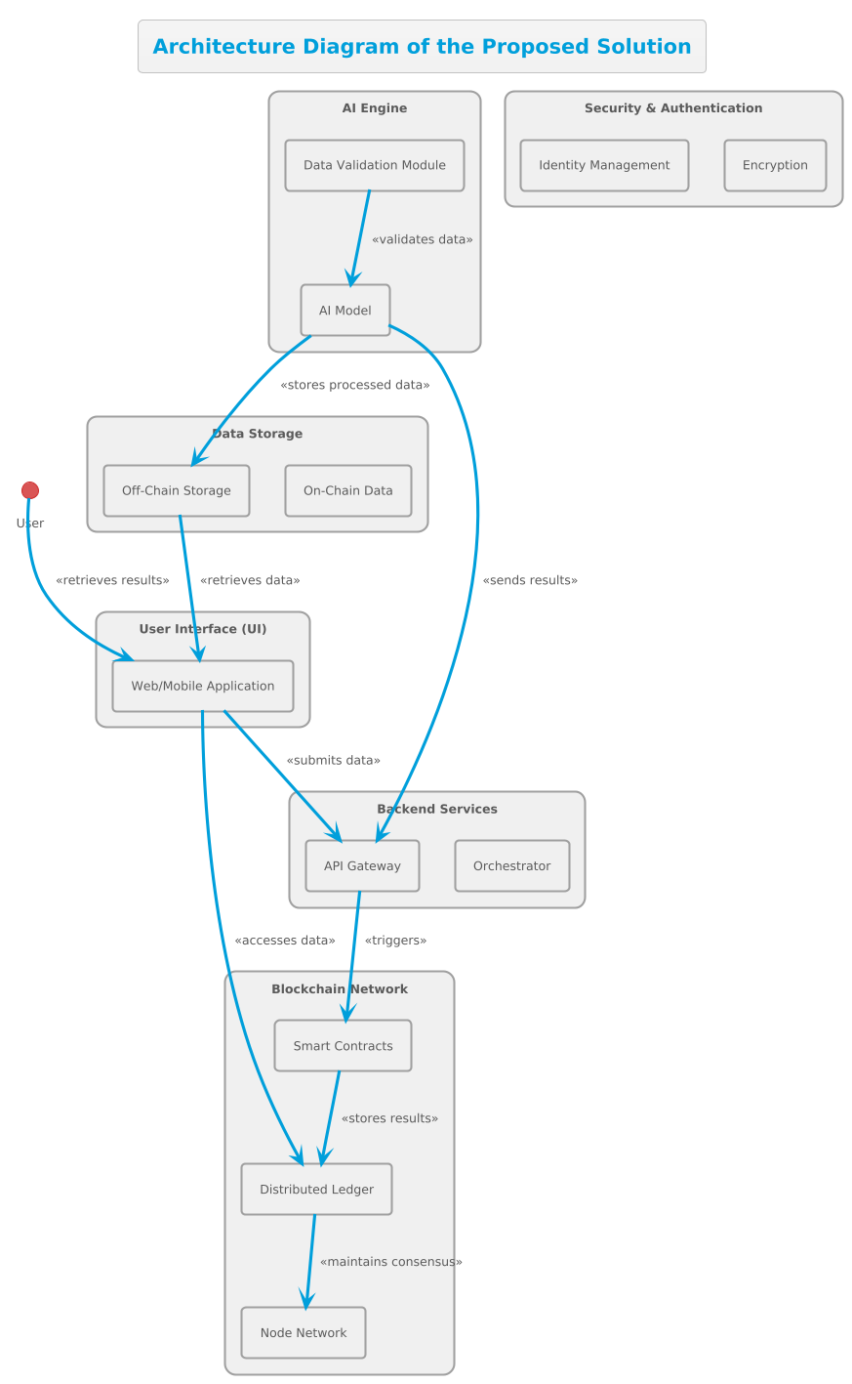
Architecture diagram of the proposed solution

Slide 10
Technologies to be used in the solution
This solution would tap into several diverse layers of technologies to create a dynamic, secure, and efficient system. For the frontend , we shall use React.js or Angular.js for developing a responsive user interface, and React Native would allow cross-platform mobile app support. This would accompany appropriate structure and styling with HTML5 and CSS3 and frameworks such as Bootstrap or Material-UI for UI design enhancement. On the backend, Node.js combined with Express.js will be a foundation to develop services and the API gateway that will interact with the frontend, AI engine, and blockchain. The primary language for all AI and machine learning tasks is Python, which directly interacts with data validation and processing. The system will utilize Restful APIs or GraphQL for structured API requests. TensorFlow or PyTorch is used for the development of AI models and their deployment, respectively. Validation and preprocessing of data are done using Scikit-learn.

Slide 11
Data manipulation is handled by both Pandas and NumPy. Containerization of the AI models so that they run suitably across different environments is done with Docker. The blockchain component utilizes Ethereum for the deployment of smart contracts and has Solidity as its programming language for contract development. We make use of Web3.js for interacting with the blockchain and if a permissioned network is your choice, Hyperledger Fabric can be used. Data storage strategies include the use of IPFS in storing big data in a decentralized manner, while PostgreSQL or MongoDB are used for non-critical off-chain data. On-chain data key-value storage purposes for Ethereum clients are implemented through LevelDB. Under security and authentication, users are authenticated using OAuth2, whereas JWT is implemented for managing secure sessions as well as encrypted communication over SSL/TLS. Wallet integrations are done through Metamask and WalletConnect. For DevOps and infrastructure management, Kubernetes orchestrates containerized applications with agility in high resiliency, and Terraform deals with cloud resources through IaC, the concept of infrastructure as code.
We use the concept of serverless computing by using AWS Lambda or Azure Functions for doing code execution on the grounds of certain specific events, and we also do CI/CD pipeline establishment using some tools like Jenkins or GitLab CI for automating testing and deployment.
Finally, performance metrics would be greatly enhanced in these monitoring and logging capabilities by means of Prometheus, Grafana for visualization, and the ELK Stack (Elasticsearch, Logstash, Kibana) to have central logging and analysis of system logs. This technology stack shall ensure the solution is not only functional and user-friendly but also secure, scalable, and maintainable.

Slide 12
Estimated implementation cost (optional)
1. Development Costs:
Frontend Development:
React.js/Angular.js: $15,000 - $50,000
React Native (if mobile): $10,000 - $40,000
HTML5/CSS3, Bootstrap/Material-UI: $5,000 - $15,000
Backend Development:
Node.js with Express.js: $15,000 - $40,000
Python for AI/ML: $20,000 - $50,000
API Development (REST/GraphQL): $5,000 - $15,000
AI/ML Development:
Model Development (TensorFlow/PyTorch): $20,000 - $60,000
Data Validation and Preprocessing: $5,000 - $15,000
Blockchain Development:
Smart Contract Development (Solidity): $10,000 - $30,000
Ethereum Network Integration: $5,000 - $15,000

Slide 13
Estimated implementation cost (optional)
2. Infrastructure Costs:
Cloud Services: $1,000 - $5,000/month
Off-Chain Storage: $500 - $2,000/month
3. Licensing Costs: $2,000 - $10,000
4. Security and Compliance Costs: $5,100 - $20,500
5. DevOps Costs: $1,500 - $5,000/month
6. Maintenance and Support Costs: $10,000 - $50,000 annually
7. Estimated Total Costs:
Initial Development: $100,000 - $400,000
Monthly Operational: $5,000 - $20,000

Slide 14
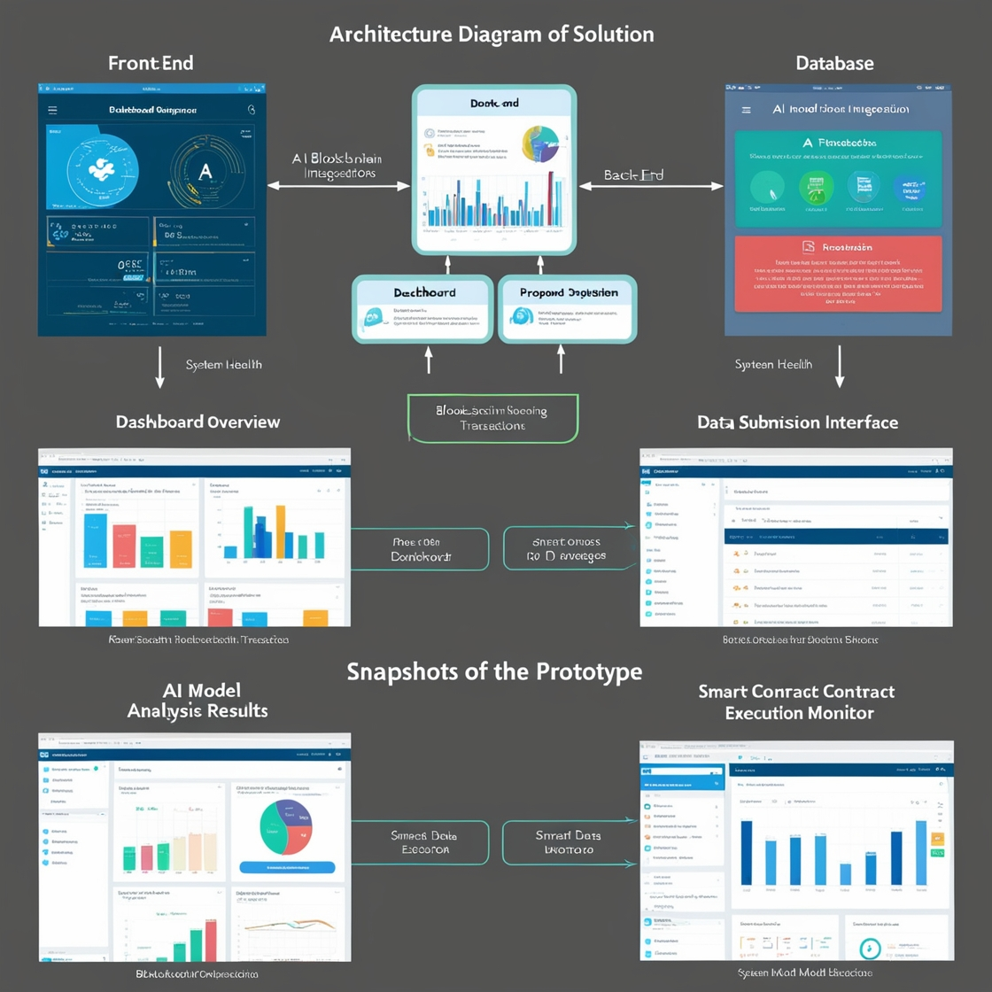
Prototype Performance report/Benchmarking

Slide 15
Prototype Performance Report/Benchmarking
AI in Blockchain Performance Report
Date: August 31, 2024
Environment:
CPU: Intel Xeon 6248R
GPU: NVIDIA Tesla V100
RAM: 64GB DDR4
Storage: 1TB SSD RAID 0
OS: Ubuntu 20.04 LTS
AI Framework: TensorFlow 2.12
Blockchain Network: Ethereum (Goerli Testnet)
Database: PostgreSQL 13.3
1. AI Model Performance
1.1 Inference Time
Model Used: Deep Neural Network (DNN)
Dataset: 10,000 property records with 100 features each
Average Inference Time: 120 milliseconds per record
Standard Deviation: ±5 milliseconds

Slide 16
Prototype Performance Report/Benchmarking
1.2 Accuracy
Validation Dataset: 2,000 labeled property records
Model Accuracy: 92.7%
Precision: 91.4%
Recall: 89.9%
1.3 Resource Utilization
CPU Utilization: 55% average during inference
GPU Utilization: 75% average during training
Memory Usage: 8GB during inference, 45GB during training
2. Blockchain Transaction Performance
2.1 Transaction Throughput
Test Scenario: Simulated 500 concurrent transactions
Average Throughput: 25 transactions per second (TPS)
Peak Throughput: 30 TPS

Slide 17
2.2 Latency
Average Latency: 15 seconds (from submission to confirmation)
95th Percentile Latency: 20 seconds
2.3 Gas Costs
Average Gas Cost per Transaction: 0.0035 ETH (~$5.00 at current prices)
Optimized Contract Cost: 0.0028 ETH (~$4.00)
3. System Scalability
3.1 Load Testing
Concurrent Users Simulated: 1,000 users
Average Response Time: 850 milliseconds
Peak Response Time: 1.5 seconds during peak load
3.2 Scalability Test
User Load: Increased from 100 to 1,000 users in 10 minutes
System Behavior: No significant degradation in performance up to 800 users; minor slowdowns observed beyond that.
4. Security & Reliability
4.1 Security Testing
Vulnerability Scans: Conducted using OWASP ZAP and custom scripts
Critical Issues Found: None
Medium Severity Issues: 1 (related to outdated SSL configuration)
Fixes Applied: Updated SSL configuration and re-scanned

Slide 18
4.2 Data Integrity
Blockchain Data Retrieval: 99.8% success rate
Data Corruption Instances: 0 reported
Backup Integrity: 100% of off-chain backups verified successfully
5. Recommendations for Optimization
5.1 AI Optimization
Inference Time Reduction: Consider model quantization to decrease inference time by 30%.
Resource Management: Implement dynamic GPU allocation to optimize resource usage during peak periods.
5.2 Blockchain Optimization
Layer-2 Solutions: Evaluate Layer-2 solutions like Optimistic Rollups to enhance throughput and reduce gas costs.
Smart Contract Optimization: Further optimization of smart contract code to lower gas costs by 15%.
5.3 System Optimization
Autoscaling: Implement an autoscaling policy in Kubernetes to manage user load more efficiently.
Caching: Introduce a caching layer for frequently accessed data to reduce response time.

Slide 19
Additional Details/Future Development (if any)
1. Smart Contracts Future Development: Advanced AI enables greater integration of smart contracts with more developed decision-making capabilities. AI models will analyze complex data sets and automatically trigger conditions set forth in contracts according to real-time data input. It can execute contracts and adapt conditions by modifying various inputs. It may result in dynamic contracts that continuously alter terms based on ongoing data or environmental changes. 2. Security: Next Evolution: AI-based cybersecurity tools can be developed into autonomous detection systems on blockchain networks. As AI will continue to learn emerging threats and anomalies, it can present real-time protection while possibly countering attacks even before they affect the network. Soon, AI applications will not only detect vulnerabilities in smart contracts but also stop malicious exploits.

Slide 20
Additional Details/Future Development (if any)
3. Scalability Future Development: AI algorithms can be used to apply consensus mechanisms or enhance current ones to create new ones to be able to have scalable blockchain networks without compromising their decentralization merits. In the case of large, public blockchains, AI can help in optimizing transaction processing and even the validation of data to enhance throughput. Machine learning models can predict bottlenecks in traffic and suggest paths for transaction data to improve network flow.

Slide 21
Provide links to your:
GitHub Public Repository
Demo Video Link (3 Minutes)
Final Product Link

Slide 22
